Slide 1
Making tables in r
rmarkdown
R packages
arsenal
kable & kablEextra
finalfit
pandoc
knitr
Other resources

Slide 2




Making tables in r
rmarkdown
R packages
arsenal
kable & kableExtra
finalfit
pandoc
knitr
Other resources

Slide 3
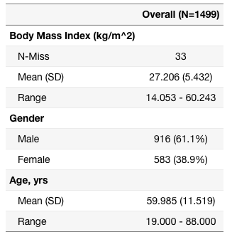
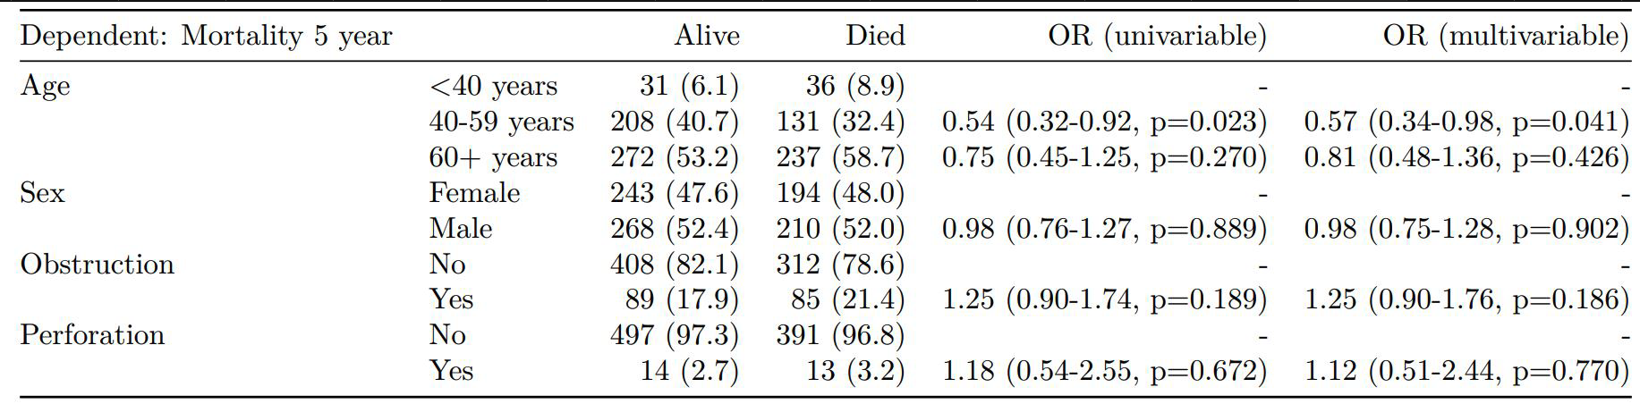
Making tables in r
+
+
=
+
+
=

Slide 4
rmarkdown
Reproducible research framework
Open-source tool for producing reports in R
Code, results, plots, and writing in one place
PDF, Microsoft Word, a slideshow, or an HTML
Simple and easy to use
Includes required packages; pandoc & knitr (may wish to install LaTex for PDFs)

Slide 5
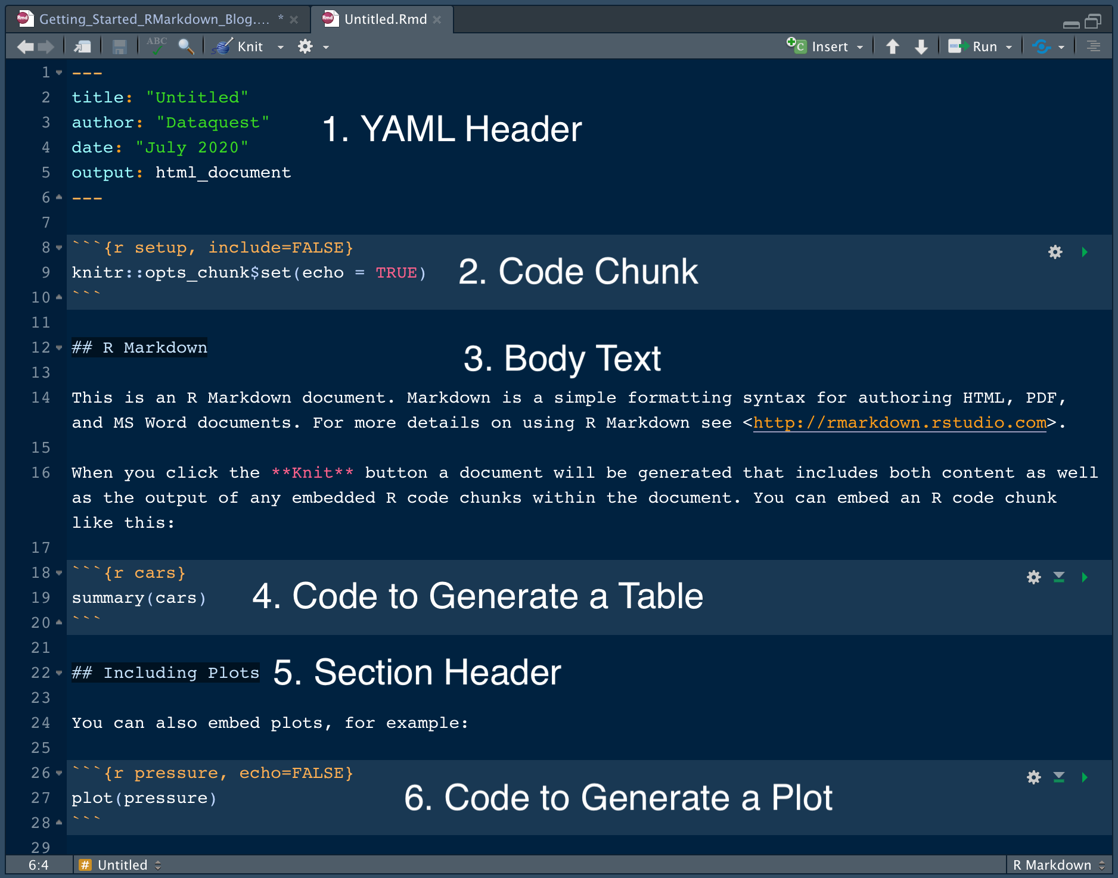
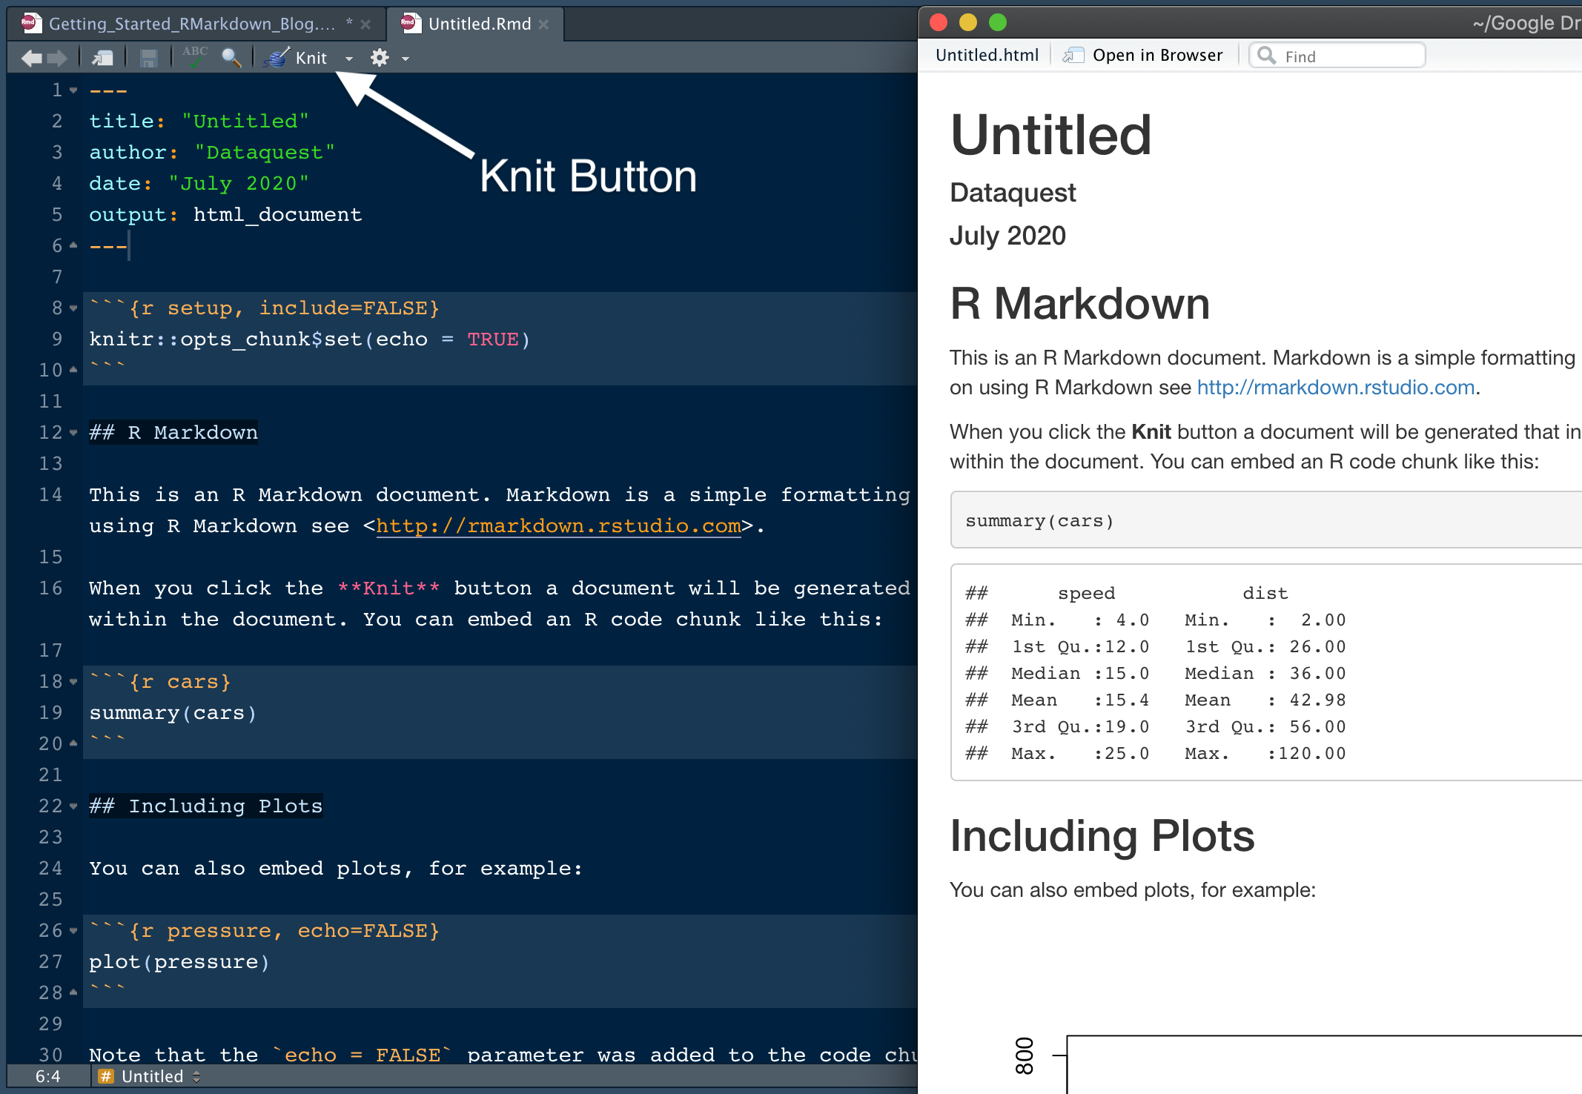
rmarkdown

Slide 6
rmarkdown

Slide 7
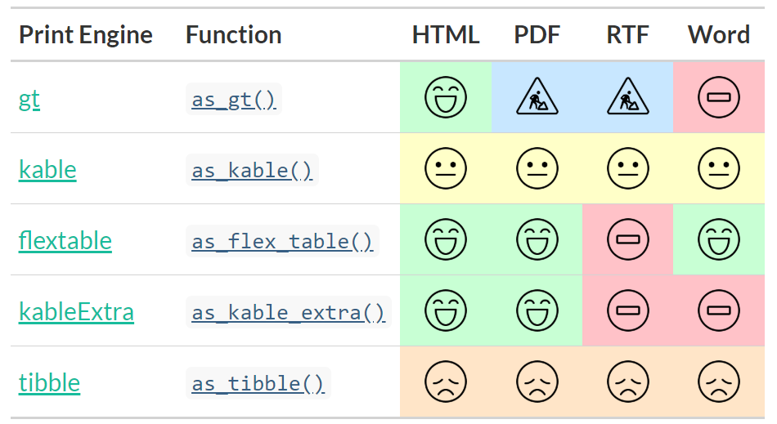
Other options
qwraps2
huxtable
tableone
gtsummary
flextable

